Slide 1

Experiment 1
Image size – $100×100$
No. of projections – 30000
No. of clusters – 180
Noise – 30%
Uniform distribution of angles

Slide 2
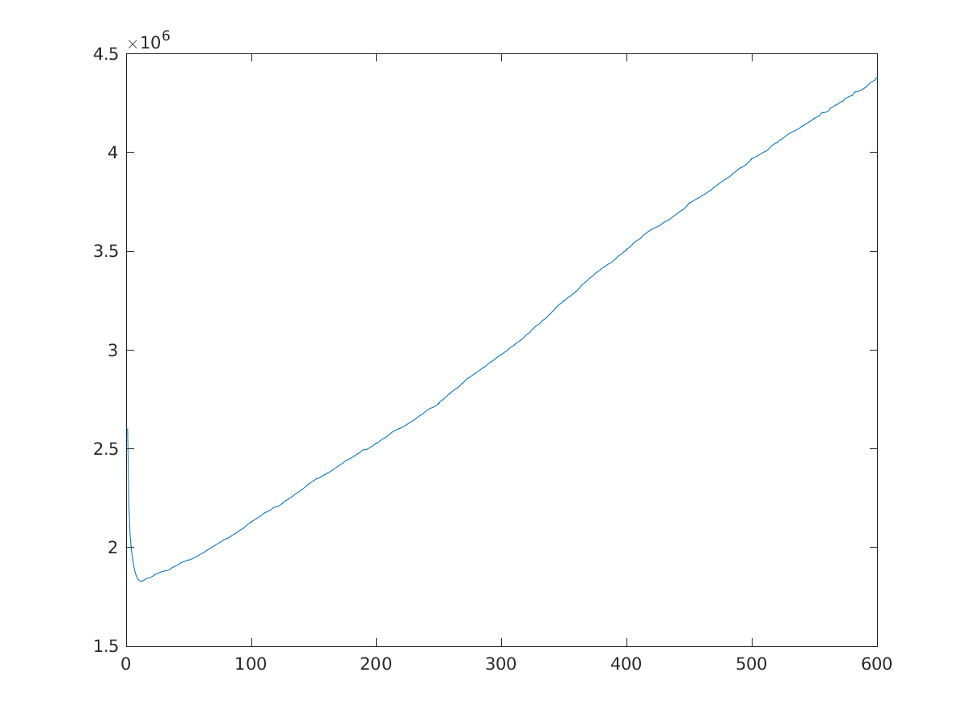
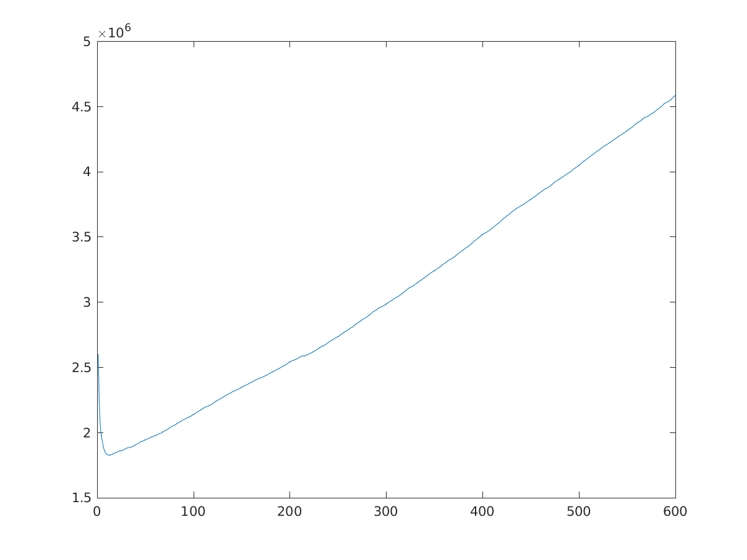
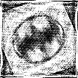
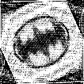
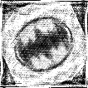
Relative reconstruction error
Initial Estimate | 40.78%
Refinement without using symmetry | 54.96%
Refinement using symmetry | 41.65%
Refinement using symmetry
Non-symmetric convergence
Refinement without using symmetry
Estimate returned by HLCC
Symmetric convergence

Slide 3

Experiment 2
Image size – $100×100$
No. of projections – 30000
No. of clusters – 180
Noise – 30%
Non-Uniform distribution of angles

Slide 4
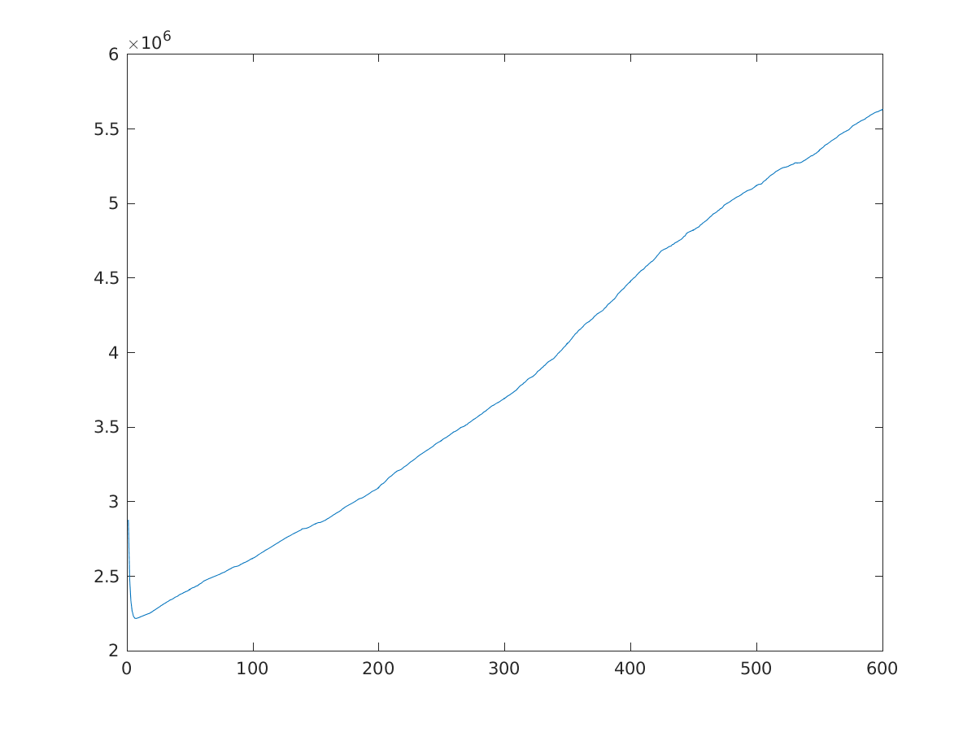
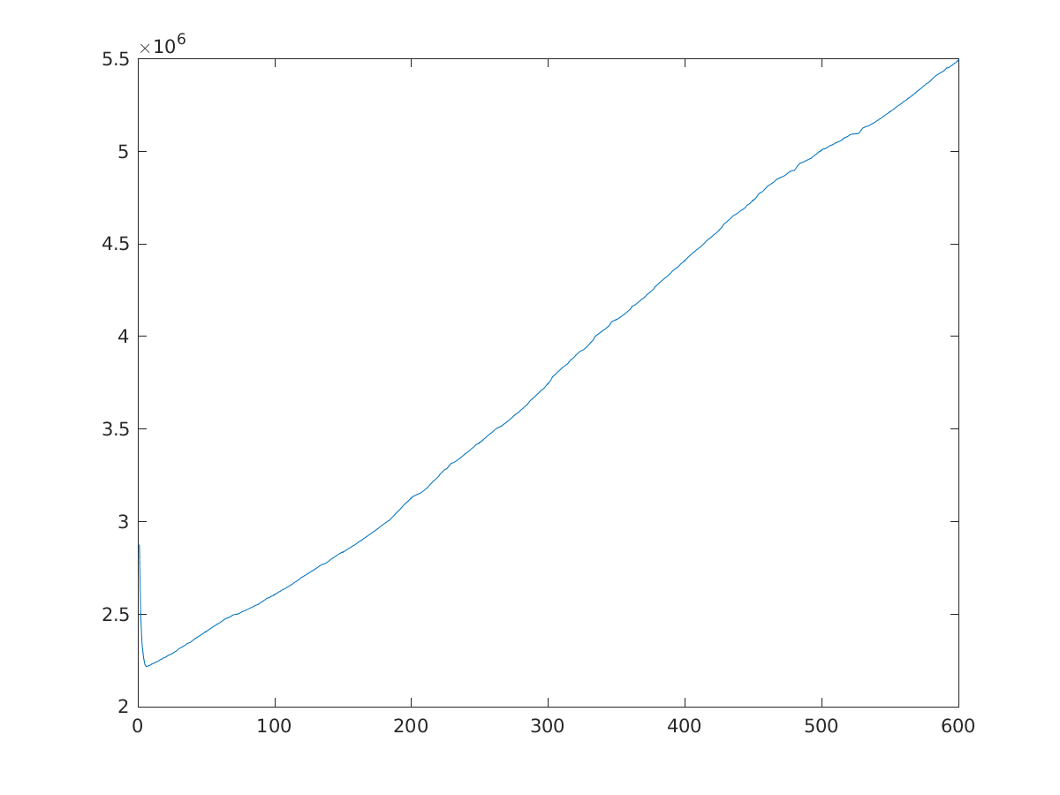
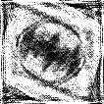
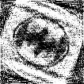
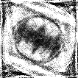
Relative reconstruction error
Initial Estimate | 48.82%
Refinement without using symmetry | 56.15%
Refinement using symmetry | 47.61%
Refinement using symmetry
Non-symmetric convergence
Refinement without using symmetry
Estimate returned by HLCC
Symmetric convergence

Slide 5

Experiment 3
Image size – $100×100$
No. of projections – 30000
No. of clusters – 180
Noise – 50%
Uniform distribution of angles

Slide 6
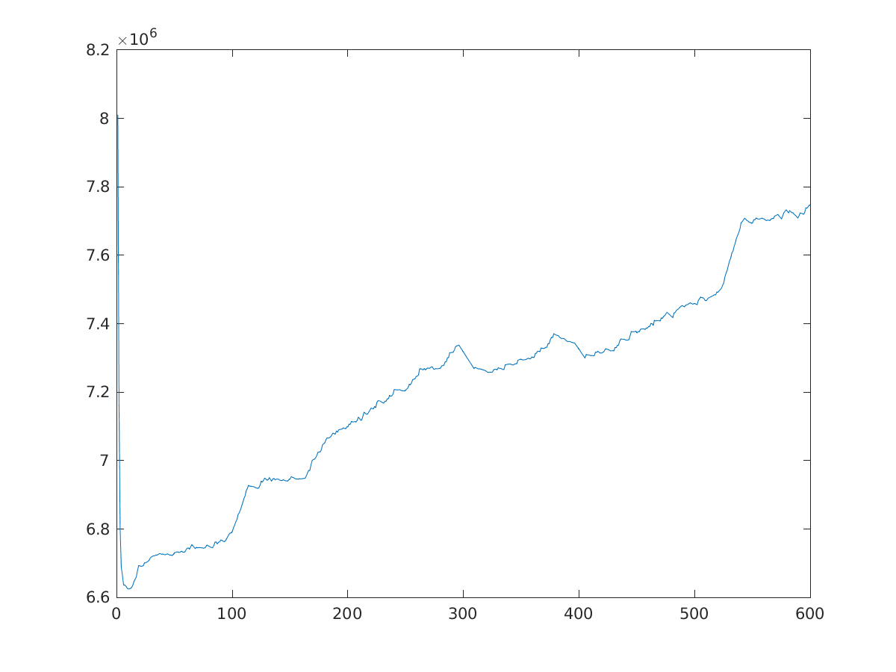
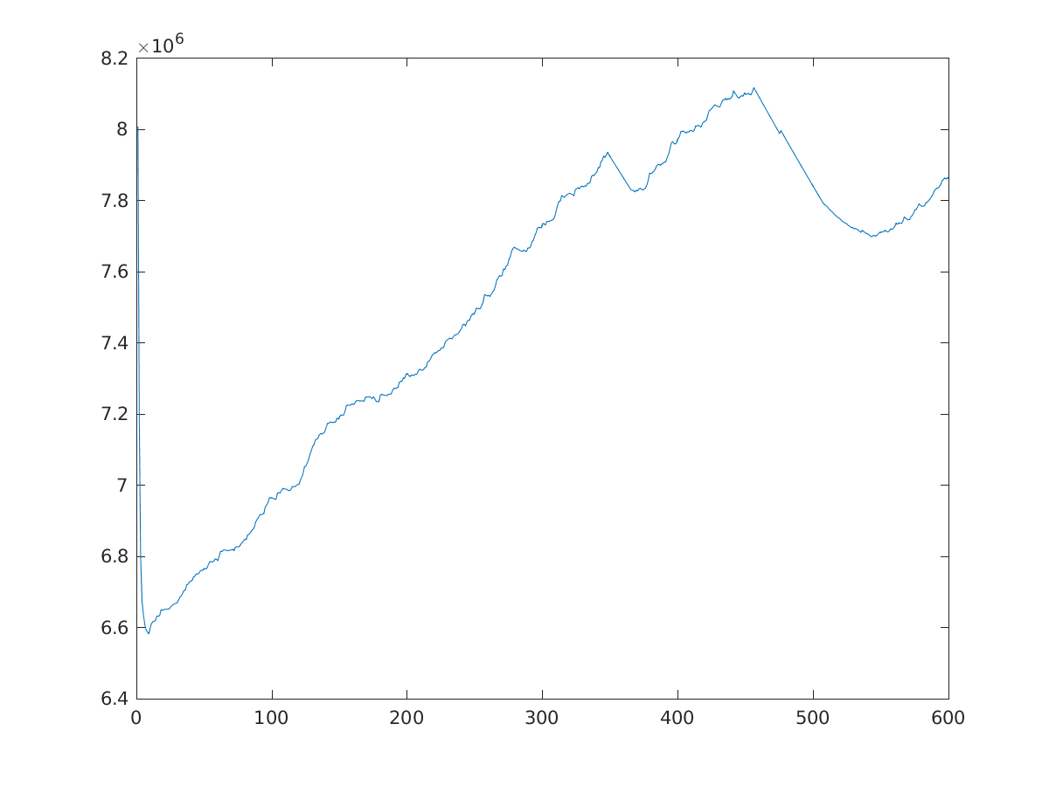
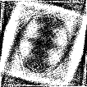
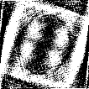
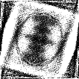
Relative reconstruction error
Initial Estimate | 81.76%
Refinement without using symmetry | 75.66%
Refinement using symmetry | 71.22%
Refinement using symmetry
Non-symmetric convergence
Refinement without using symmetry
Estimate returned by HLCC
Symmetric convergence

Slide 7

Experiment 4
Image size – $100×100$
No. of projections – 20000
No. of clusters – 180
Noise – 40%
Uniform distribution of angles

Slide 8
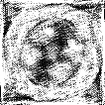
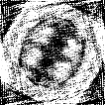
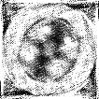
Relative reconstruction error
Initial Estimate | 51.55%
Refinement without using symmetry | 77.11%
Refinement using symmetry | 57.57%
Refinement using symmetry
Non-symmetric convergence
Refinement without using symmetry
Estimate returned by HLCC
Symmetric convergence

